Slide 1
SHELL UNITY INTRODUCTION
GUI & Audio

Slide 2
PART ONE
Graphical User Interfaces

Slide 3
GUI and HUD
A GUI is a visual interface to the underlying systems in our game.
In Games, an obvious example of a type of GUI is the HUD, or Heads-Up Display.
The HUD is used to simultaneously display several pieces of information to the player; such as lives, time, score, items, maps, compasses, mana, gold, units, targeting information, objectives, tutorial text, etc…

Slide 4
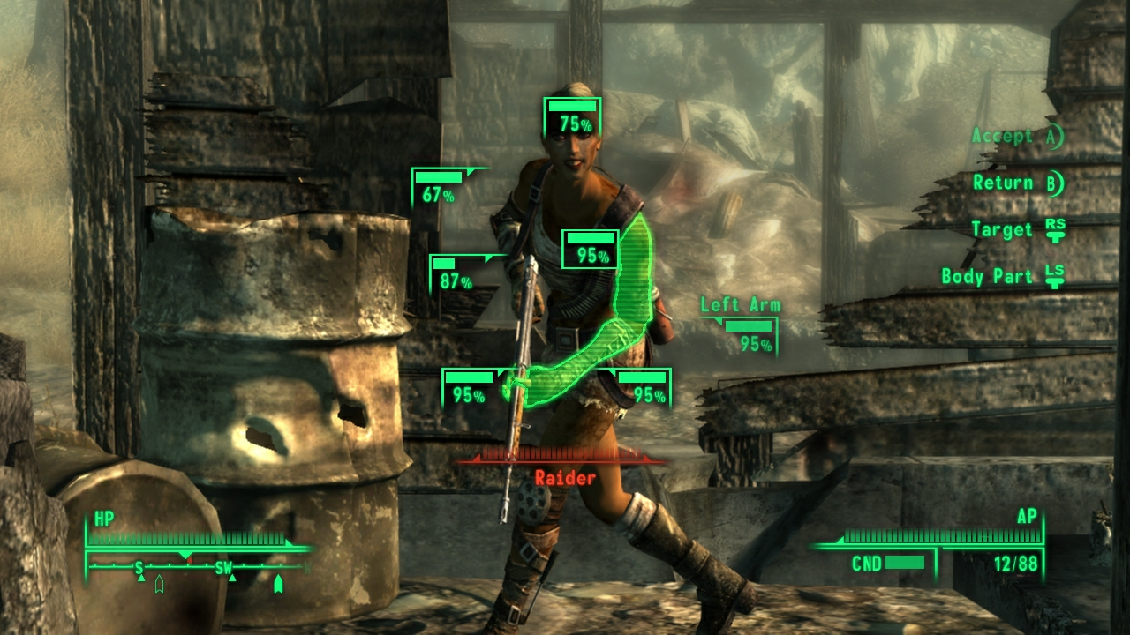
Spot the GUI

Slide 5
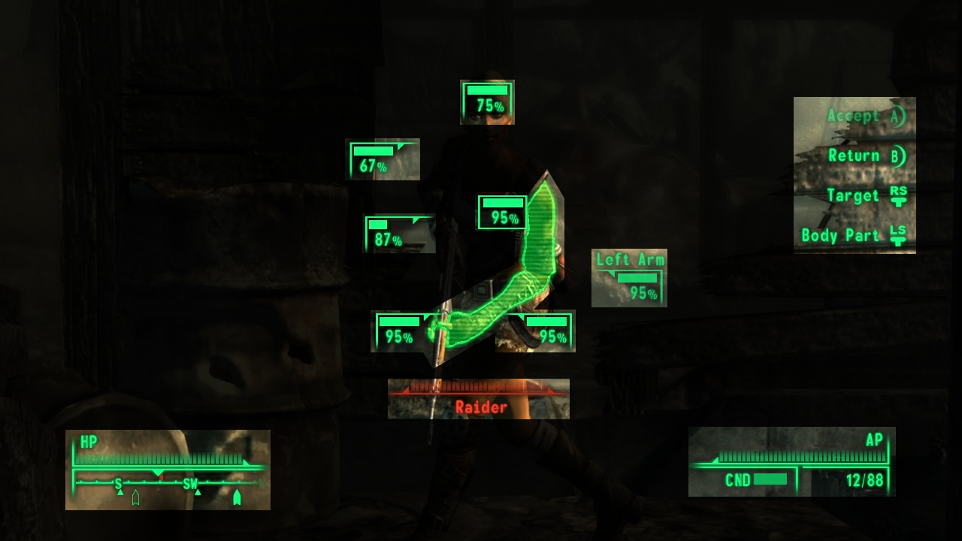
Spot the GUI

Slide 6
GUIs
HUDs are only one type of GUI; they are used to display game-related information over the top of gameplay.
The term “GUI” extends beyond this – it refers to interface elements beyond the HUD, such as menus, title screens, loading screens, etc.
Unity makes making all of these things relatively straightforward.

Slide 7
Screen Coordinates
When positioning GameObjects in our game worlds, we use 3D coordinates starting from the world origin. A virtual camera then picks up these objects and determines how they are to be positioned in terms of the final, two-dimensional picture on screen.
For GUI elements, we work directly within the 2D world of Screen Coordinates.

Slide 8
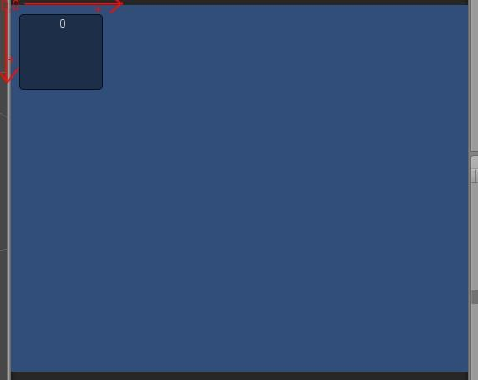
Down Is The New Up
In Screen Coordinates, the top left corner is the 2D point 0,0 (x,y).
As you traverse to the right of this point, x increases.
As you traverse down from this point, y increases.
Unity measures Screen Coordinates in pixels, meaning we have to do some extra work to create resolution-independent applications.
Notes:
This means that in an 800x600 window the bottom right pixel is 799,599

Slide 9
Unity Time!
We can create a powerful GUI entirely with scripts, using the OnGUI event handler in Unity…
You can find more information about GUIs in Unity at the Unity GUI Scripting Guide.

